Slide 1

Python for Data Science
Master. Cesar Sinchiguano
Robotics and Cybernetics

Slide 2
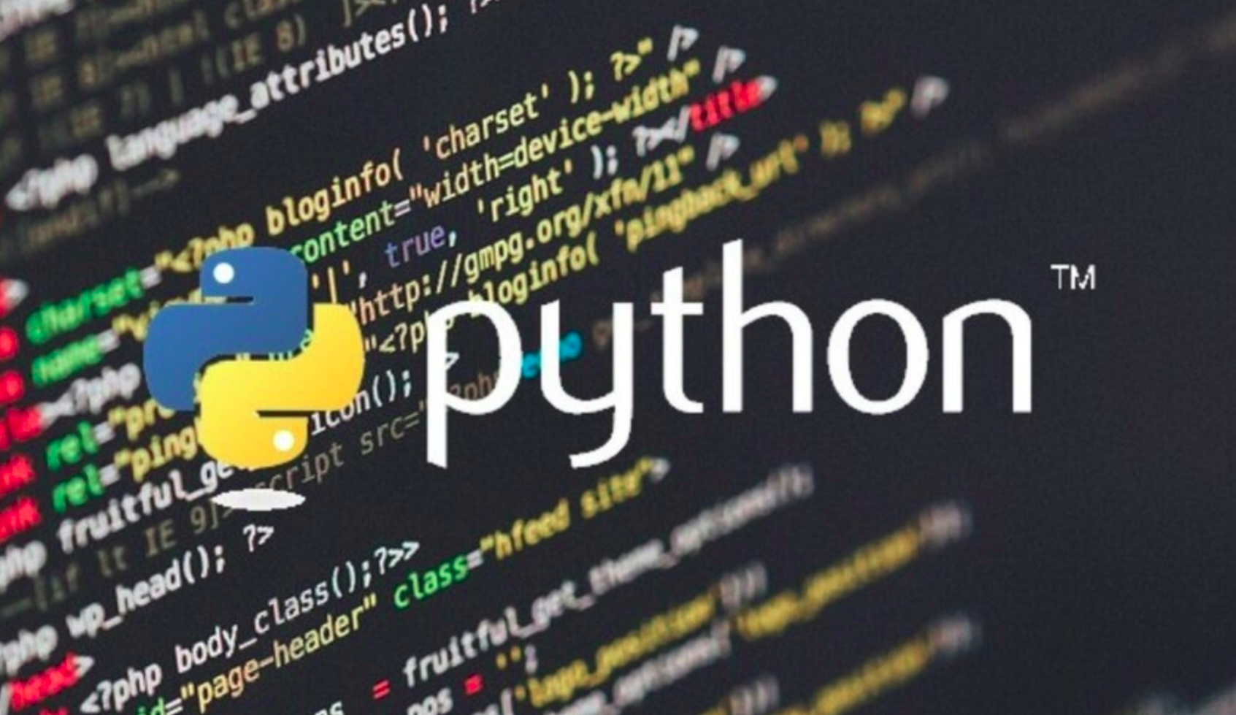
Today’s lecture
Python Introduction
What is Python?
What can Python do?
Why Python?
Good to know
Python Syntax compared to other programming languages
Python Quickstart
Python Keywords and Identifiers
Python Statement, Indentation and Comments

Slide 3
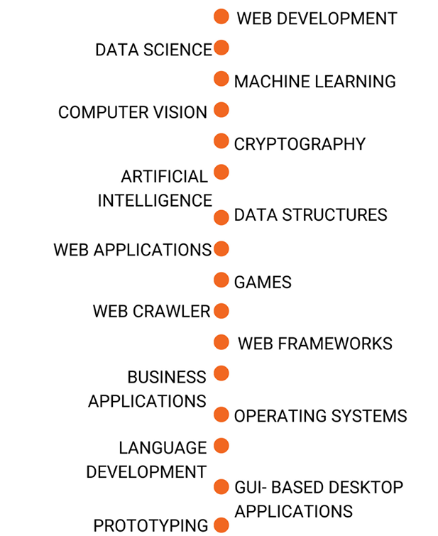
What is Python?
Python is a popular programming language.
It was created by Guido van Rossum, and released in 1991.
It is used for:
web development (server-side),
software development,
mathematics,
system scripting.
What can Python do?
Python can be used on a server to create web applications.
Python can connect to database systems. It can also read and modify files.
Python can be used to handle big data and perform complex mathematics.
Python can be used for rapid prototyping, or for production-ready software development.

Slide 4
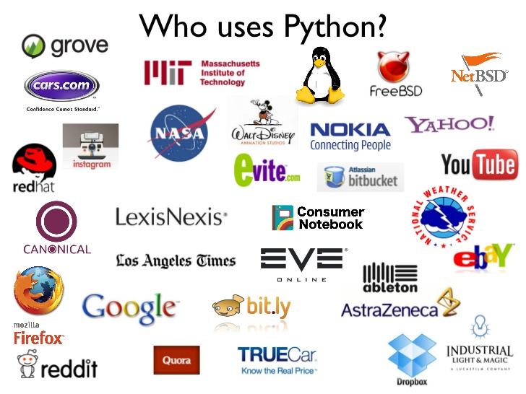
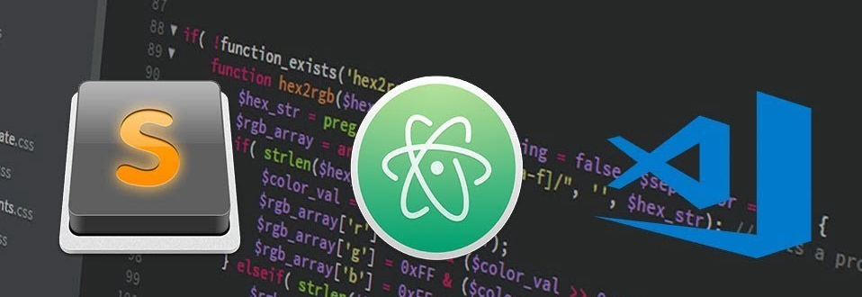
Why Python?
Python works on different platforms (Windows, Mac, Linux, Raspberry Pi, etc).
Python has a simple syntax similar to the English language.
Python has syntax that allows developers to write programs with fewer lines than some other programming languages.
Python runs on an interpreter system, meaning that code can be executed as soon as it is written.
Good to know
The most recent major version of Python is Python 3, which we shall be using in this tutorial. However, Python 2, although not being updated with anything other than security updates, is still quite popular.
In this tutorial Python will be written in a text editor. It is possible to write Python in an Integrated Development Environment, such as Thonny, Pycharm, Netbeans or Eclipse which are particularly useful when managing larger collections of Python files.

Slide 5
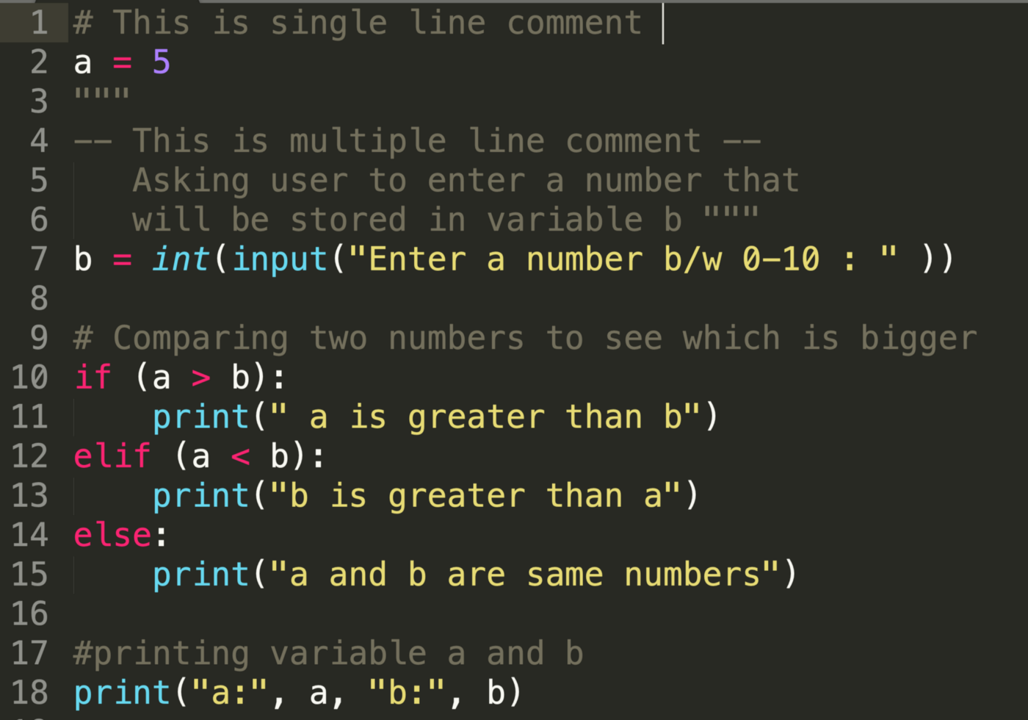
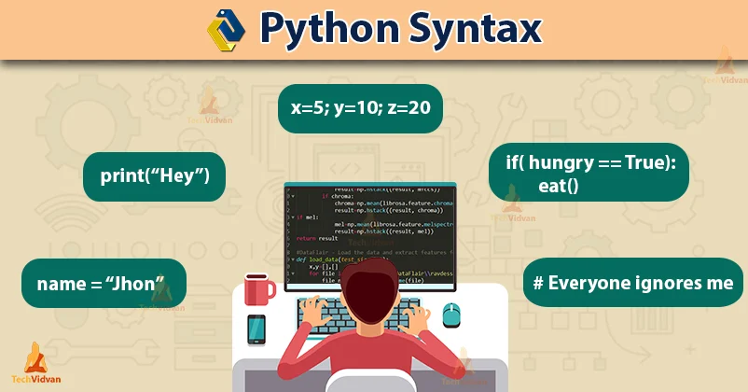
Python Syntax compared to other programming languages
Python was designed for readability, and has some similarities to the English language with influence from mathematics.
Python uses new lines to complete a command, as opposed to other programming languages which often use semicolons or parentheses.
Python relies on indentation, using whitespace, to define scope; such as the scope of loops, functions and classes. Other programming languages often use curly-brackets for this purpose.

Slide 6
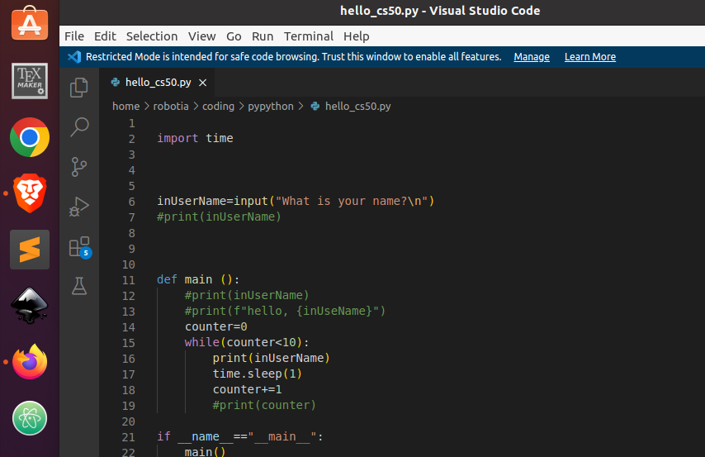
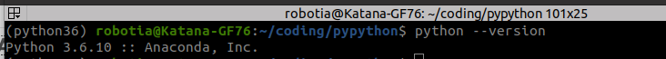
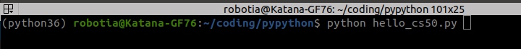
Python Quickstart
Python is an interpreted programming language, this means that as a developer you write Python (.py) files in a text editor and then put those files into the python interpreter to be executed.
To check if you have python installed on a Linux, run the following on the Command Line:
The way to run a python file is like this on the command line:

Slide 7
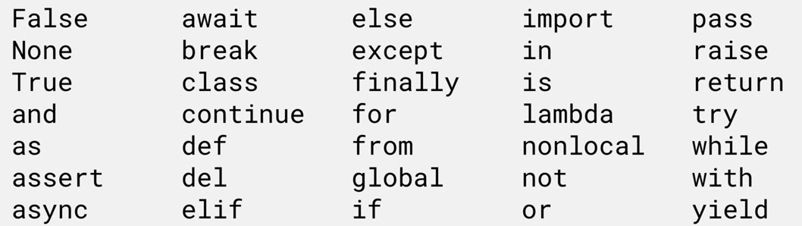
Python Keywords and Identifiers
keywords (reserved words in Python) and identifiers (names given to variables, functions, etc.).
Python Keywords
Keywords are the reserved words in Python.
We cannot use a keyword as a variable name, function name or any other identifier. They are used to define the syntax and structure of the Python language.
Python Identifiers
An identifier is a name given to entities like class, functions, variables, etc. It helps to differentiate one entity from another.
The list of all the keywords is given below.
Rules for writing identifiers
Identifiers can be a combination of letters in lowercase (a to z) or uppercase (A to Z) or digits (0 to 9) or an underscore _.
Names like myClass, var_1 and print_this_to_screen, all are valid example.
An identifier cannot start with a digit. 1variable is invalid, but variable1 is a valid name.
Syntax: The grammatical arrangement of words in a sentence

Slide 8
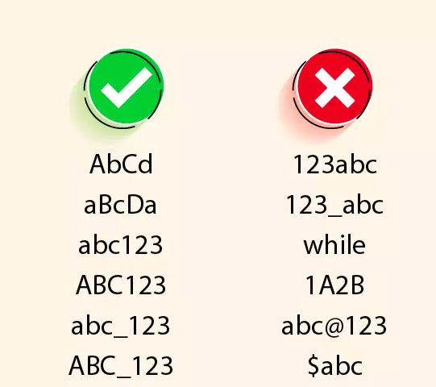
Keywords cannot be used as identifiers.
We cannot use special symbols like !, @, #, $, % etc. in our identifier.
An identifier can be of any length.
Things to Remember
Python is a case-sensitive language. This means, Variable and variable are not the same.
Always give the identifiers a name that makes sense. While c = 10 is a valid name, writing count = 10 would make more sense, and it would be easier to figure out what it represents when you look at your code after a long gap.
Multiple words can be separated using an underscore, like this_is_a_long_variable.

Slide 9
Things to Remember

Slide 10
Thanks
cesar.sinchiguano@uleam.edu.ec

Slide 11
https://www.w3schools.com/python/python_getstarted.asp
https://www.programiz.com/python-programming/variables-constants-literals
cesar.sinchiguano@uleam.edu.ec

